Slide 1
CSE 495/496 GRADUATION PROJECT Final Presentation
Hologram Projector with Raspberry Pi
Alper YAŞAR
Supervisor: Prof. Hasari ÇELEBİ
JUNE 2022

Slide 2
Context
What is Project?
Prism
Proje Design Plan
Interface
Project Requirements
Success criteria
Project Plan
Resources

Slide 3
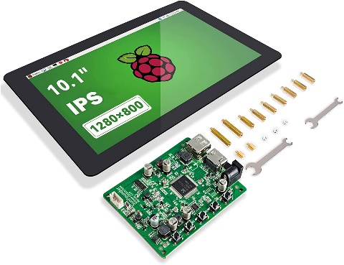
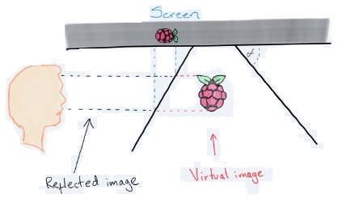
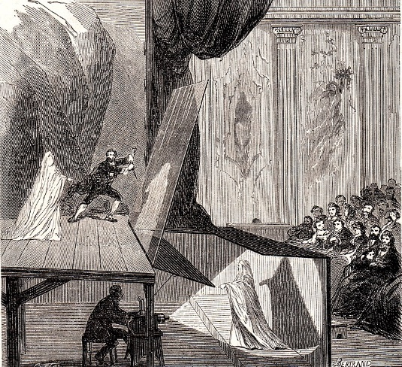
What Is Project
Hologram Projector
Displays Hologram using a Raspberry Pi
Creating a 3-D illusion displaying symmetrically opposite images that seem to float in mid-air and which are visible from different angles
Special Dimensions for prism
Based on Pepper’s Ghost.

Slide 4
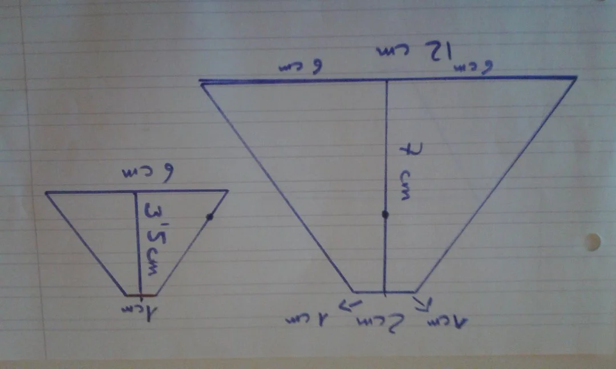
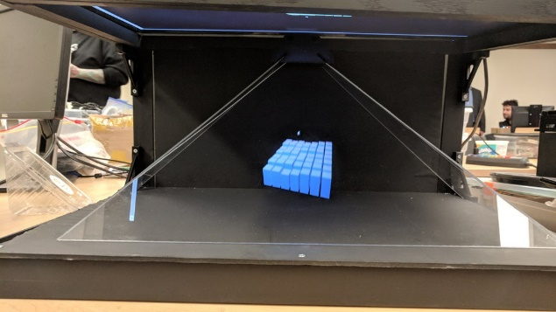
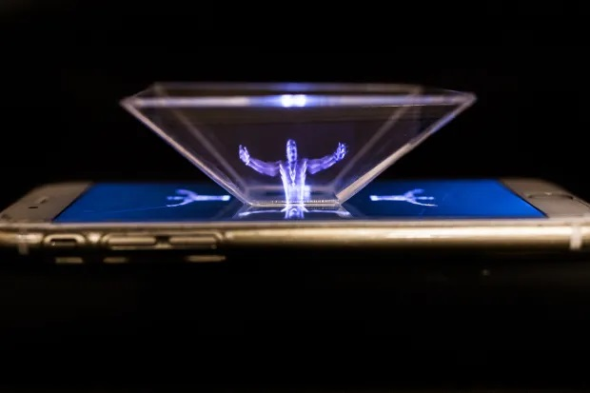
Prısm
Plexiglass
Used glass for plexi.
When put the glass to screen on right angle, it is reflecting the light.
Glass cut to special size.

Slide 5
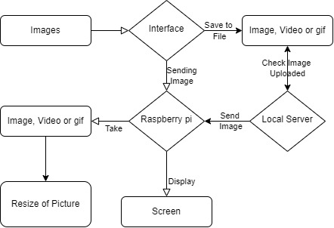
Project Design Plan
Sending images to raspberry pi and displaying it on screen.
Placing pictures in different positions, may different angle or different perspective on the screen.
There is glass pyramid on the screen and collecting light from screen in different position and collect on center.

Slide 6
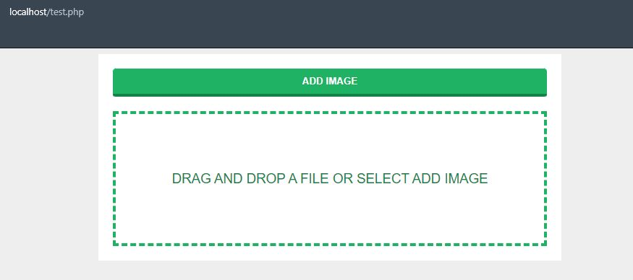
Interface
There is a simple interface for user.
User can select image from local storage.
When select the image PHP saving Image
Local server sending Image to Raspberry Pi

Slide 7
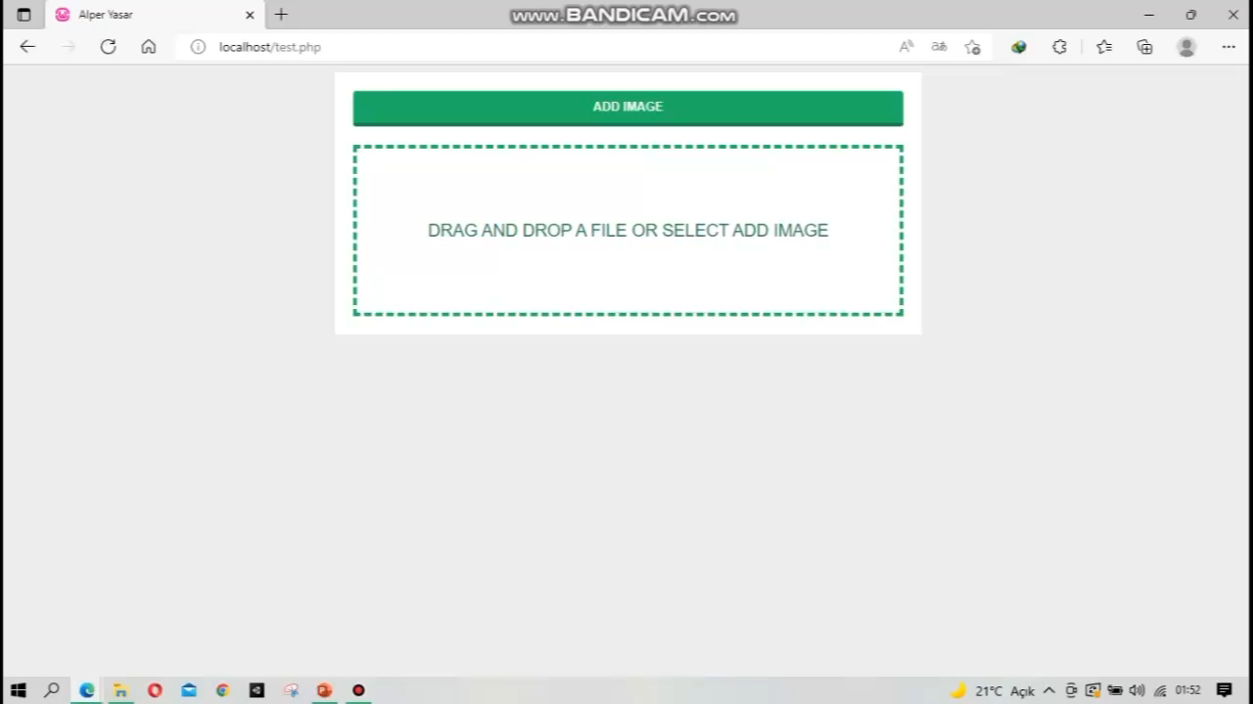
Demo

Slide 8
Project Requirements
Hardware
Raspberry Pi
Plexiglas pyramid
Mobile Phone for Screen
Wifi adapter*
Software
OpenCV
PHP – HTML - JavaScript
Python
VNC Wiever

Slide 9
Succes Criteria
Making image different position and different angle*
Sending data
Interface for user
Display as 3D*

Slide 10
Project Plan
1. Meeting
Connecting raspberry pi with phone for displaying images.*
2. Meeting
Using OpenCV making images, and display it.*
3. Meeting
Making interface and sending different datas.
4. Meeting

Slide 11
Resources
Design 3D Hologram Display Video Information of Animals in Bandung Zoo Rizal Firdaus Adhika 1 , Denny Darlis S.Si., MT. 2 , Tengku Ahmad Riza ST., MT.3, e-Proceeding of Applied Science : Vol.4, No.3 Desember 2018 | Page 2846
Hologram based Internet of Signage Design Using Raspberry Pi 1)Khudaybergenov Timur*, Jungdo Han**, Jae-Sang Cha***, Journal of The Korea Society of Computer and Information Vol. 24 No. 12, pp. 35-41, December 2019
HoVeR: The Holographic Visualizer on Raspberry Pi Manachai Toahchoodee, 2015 15th International Symposium on Communications and Information Technologies (ISCIT)
An Approach to Raspberry Pi Synchronization in a Multimedia Projection System for Applications in Presentation of Historical and Cultural Heritage Nemanja D. Savić, Dušan B. Gajić, Radomir S. Stanković, Digital Presentation and Preservation of Cultural and Scientific Heritage, Vol. 5, 2015, ISSN: 1314-4006
https://community.element14.com/challenges-projects/design-challenges/picasso/b/blog/posts/hologram-pi-ramid---intro-and-initial-design
https://www.instructables.com/Hologram-Projector-With-Pi/
https://github.com/holmos-ipm/holmos-rpi

